Slide 1
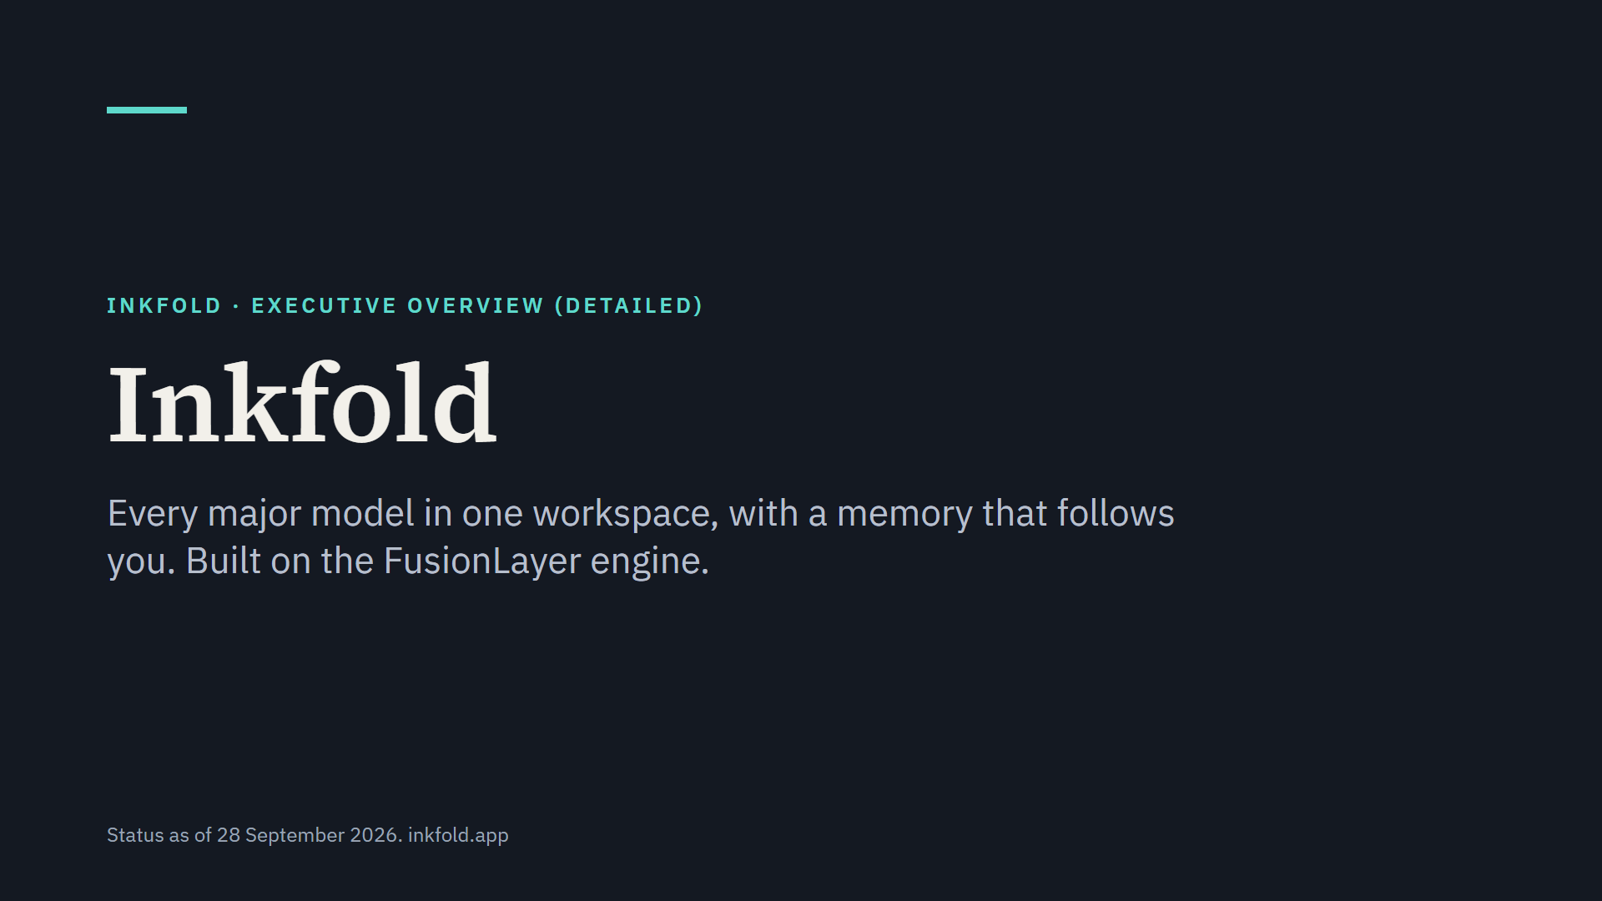
Notes:
Inkfold puts ChatGPT, Claude, Gemini and other models in one workspace with one memory, gives each model the right context, and can put several models to work on the same question. This presentation covers who it is for, how it works, the five main capabilities, what makes it different, planned pricing and what comes next.

Slide 2
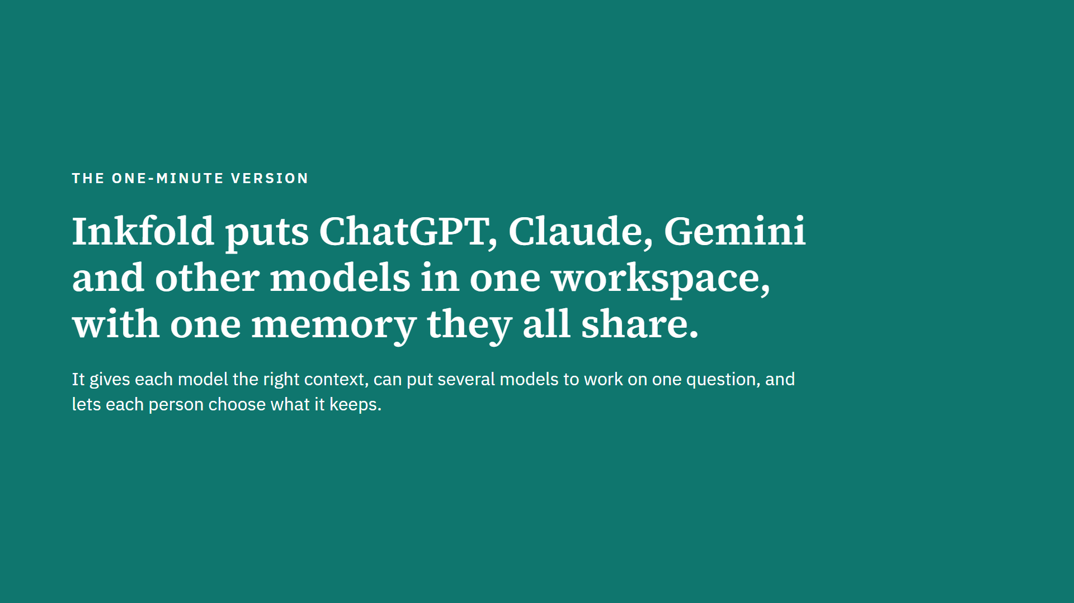
Notes:
This is the whole product in one sentence. A person talks to whichever model suits the question; Inkfold remembers the projects, preferences and facts that matter, adds the relevant ones to each new question, and for important questions asks several models at once. Privacy is chosen for each conversation.

Slide 3
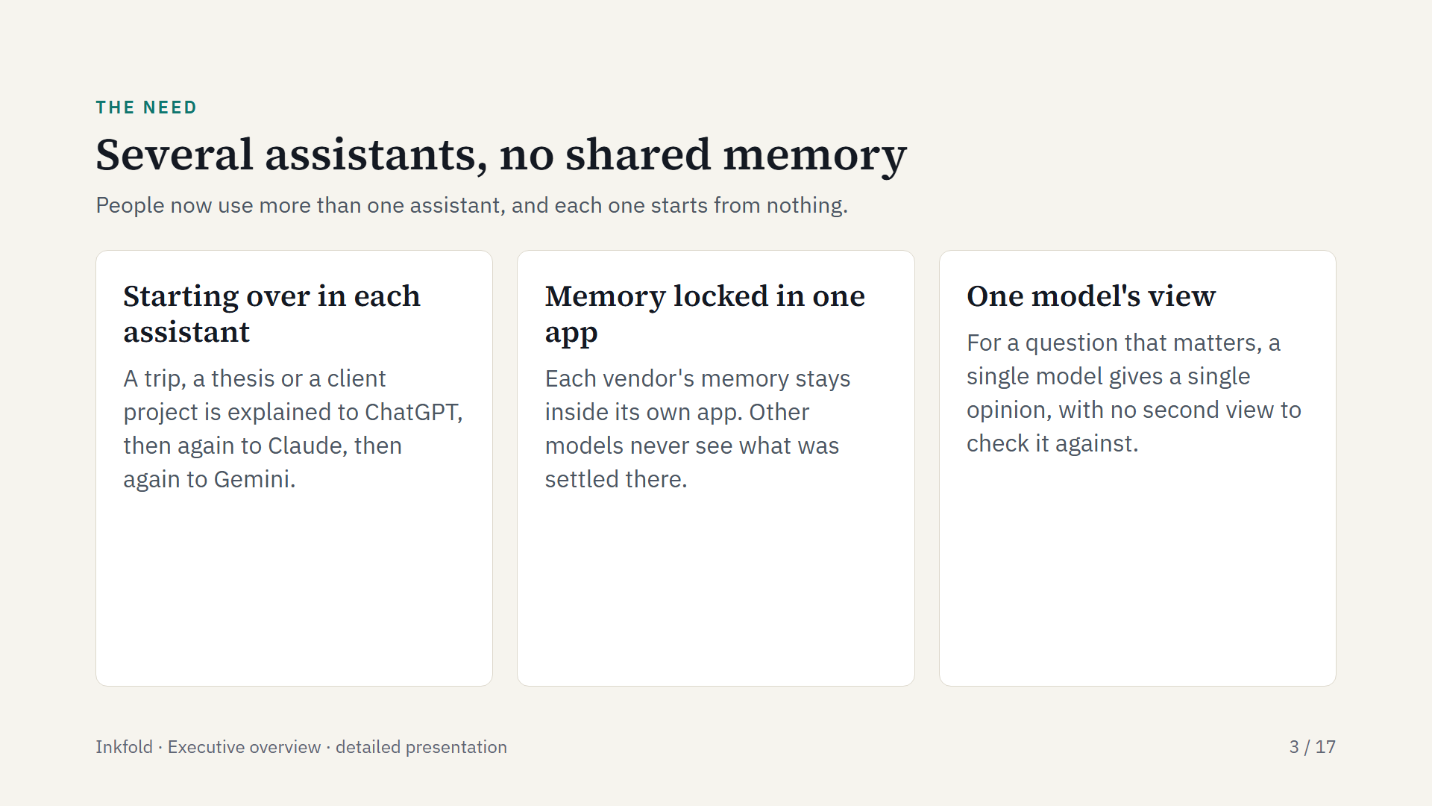
Notes:
The people Inkfold serves already use several assistants, because each is better at different things. The cost is repetition and scattered context: every assistant needs the same background again, and each vendor's memory feature only helps inside that vendor's app.

Slide 4
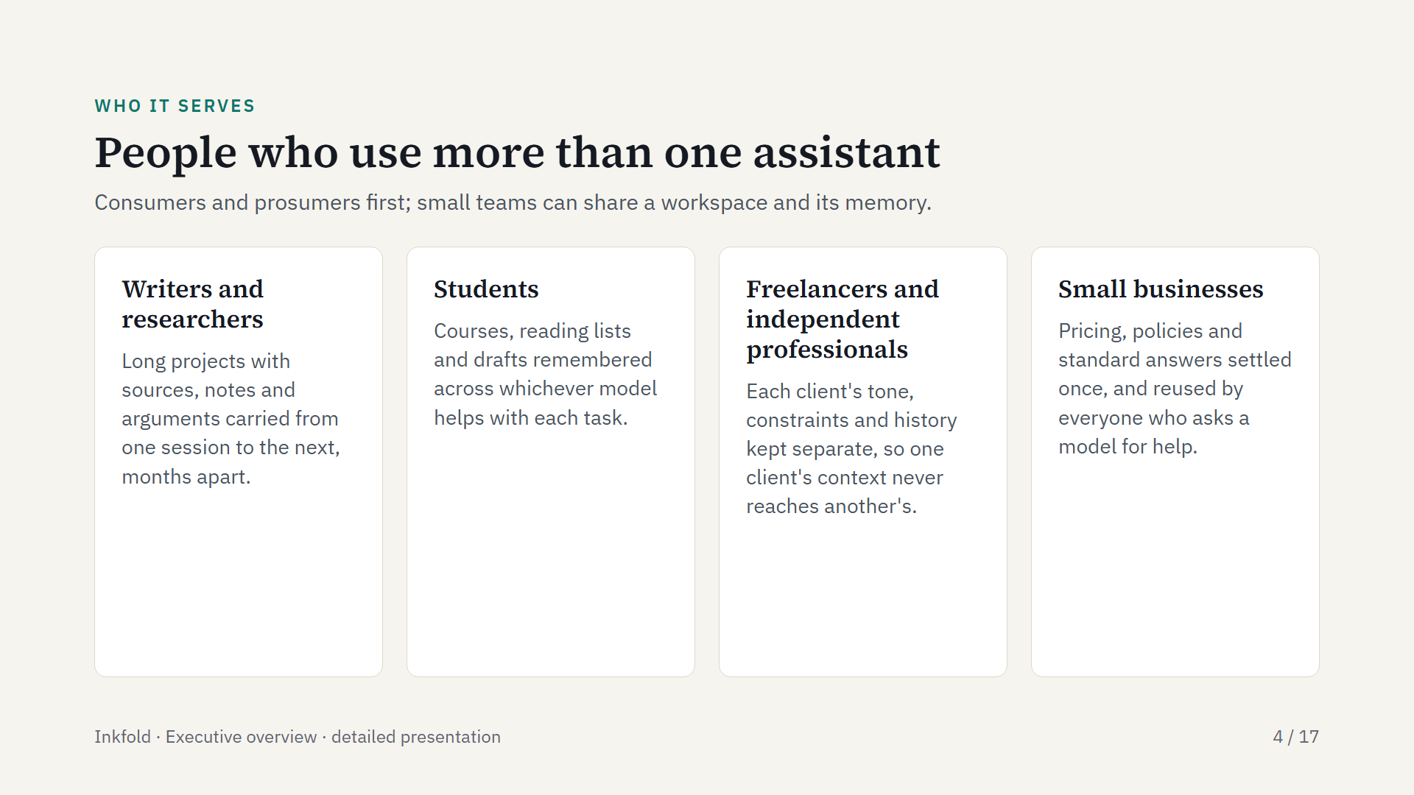
Notes:
These four groups come from Inkfold's positioning and the live site. They share one habit: they use several assistants and keep long-running work going. Teams come second: team workspaces with shared memory are in beta.

Slide 5
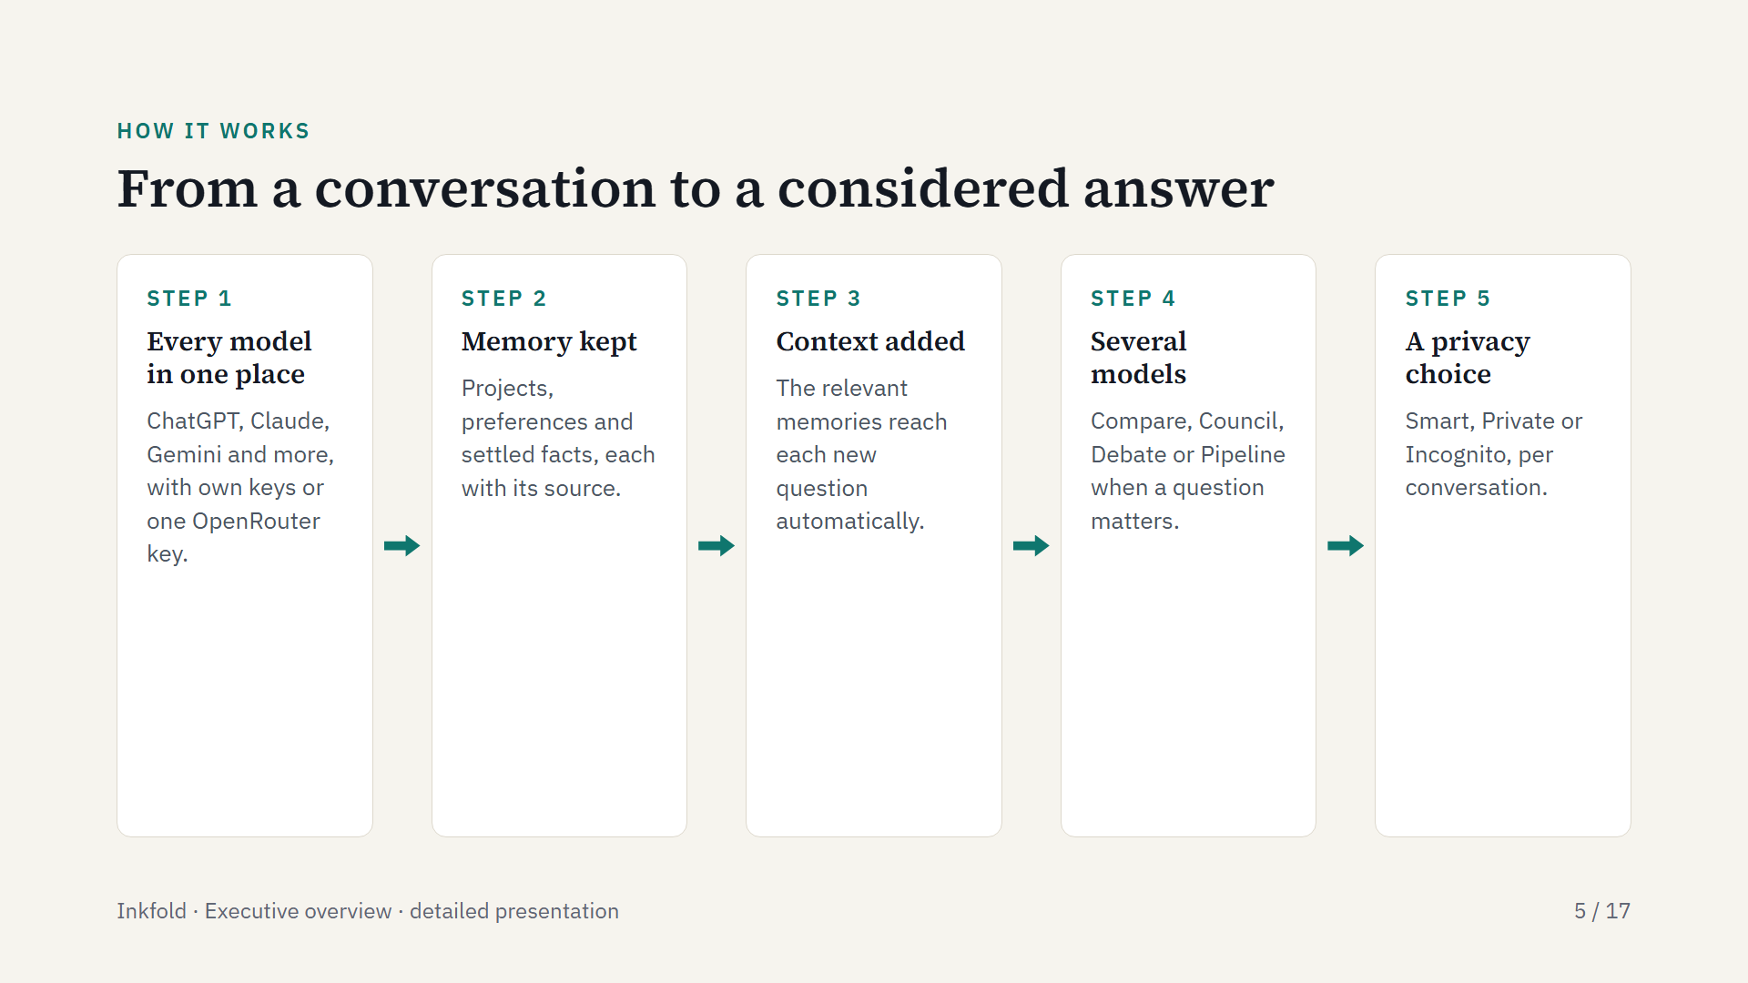
Notes:
Five steps in plain terms. The person connects the models they already use. Inkfold keeps what matters from each conversation. When a new question comes in, Inkfold looks up the relevant memories and adds only those. For important questions, several models work together. And for every conversation the person chooses how much is kept.

Slide 6
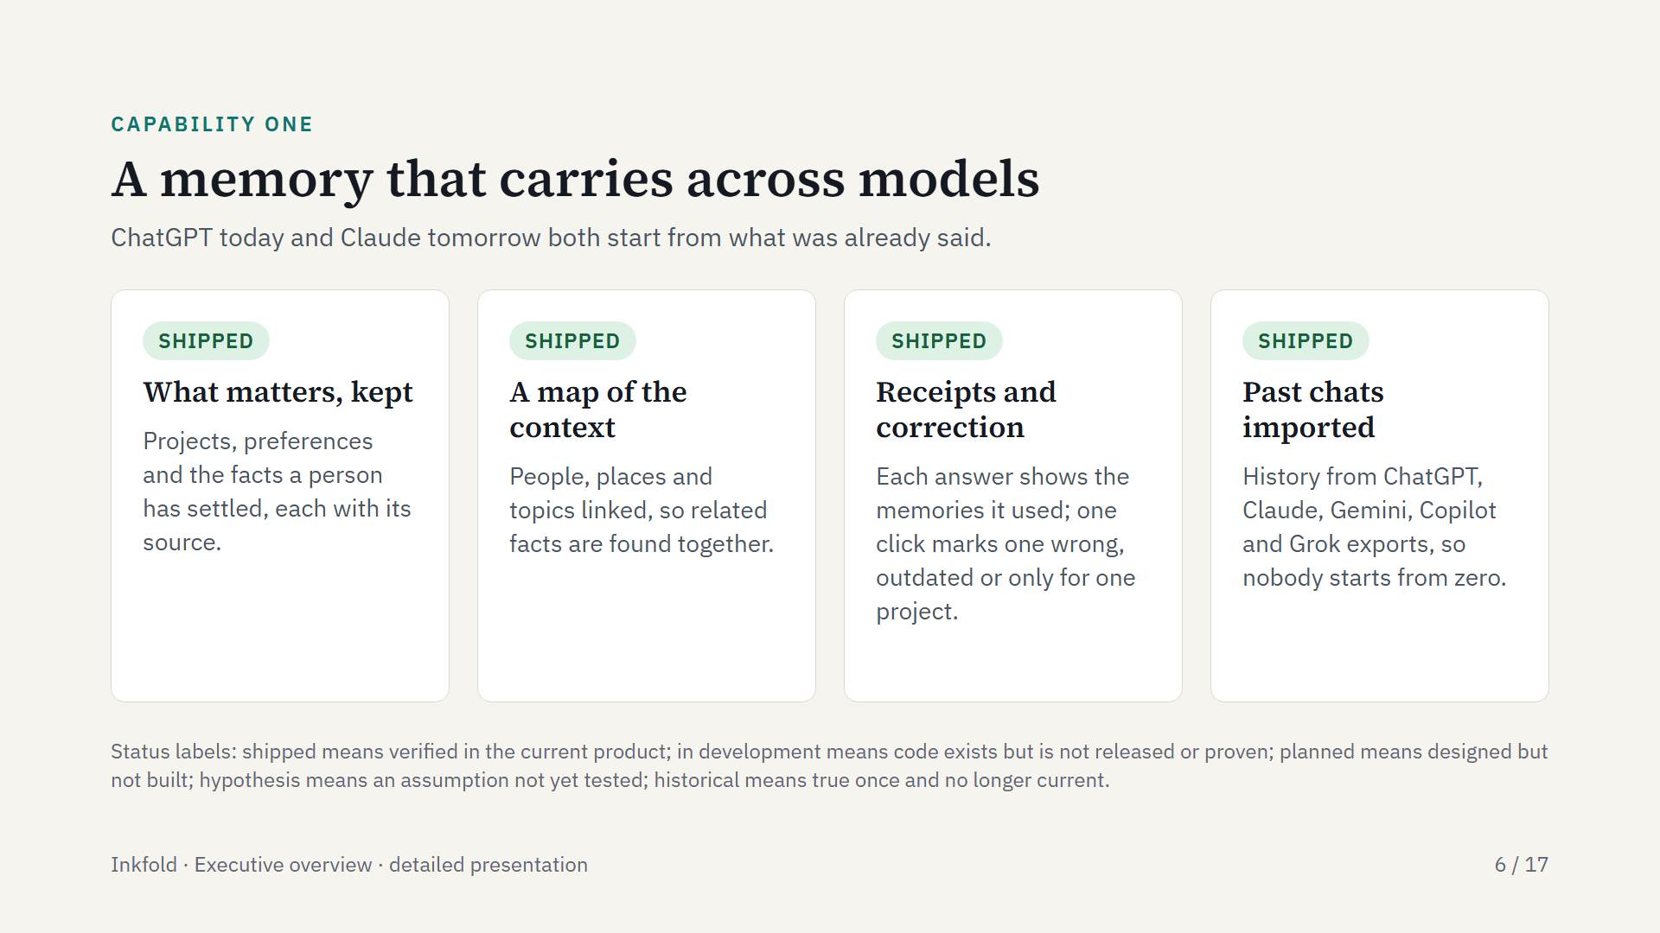
Notes:
The example on the site: a trip to Japan in April, vegetarian, prefers trains, budget about three thousand dollars. It is said once to Claude, and weeks later Gemini drafts the itinerary already knowing it. If a detail changes, the correction becomes the new record rather than a deletion.

Slide 7
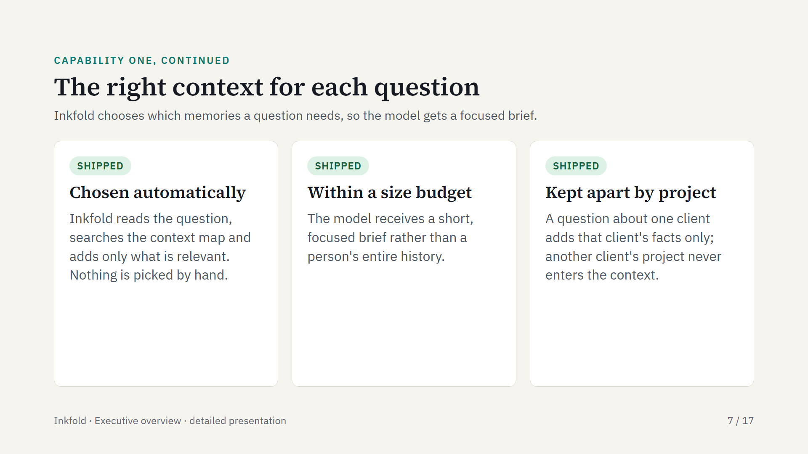
Notes:
The freelancer example: a question about the contract clause for Client A brings in Client A's facts and nothing from Client B, because the question did not call for it. This is the engine's context assembly, which recalls memories by relevance within a size budget.

Slide 8
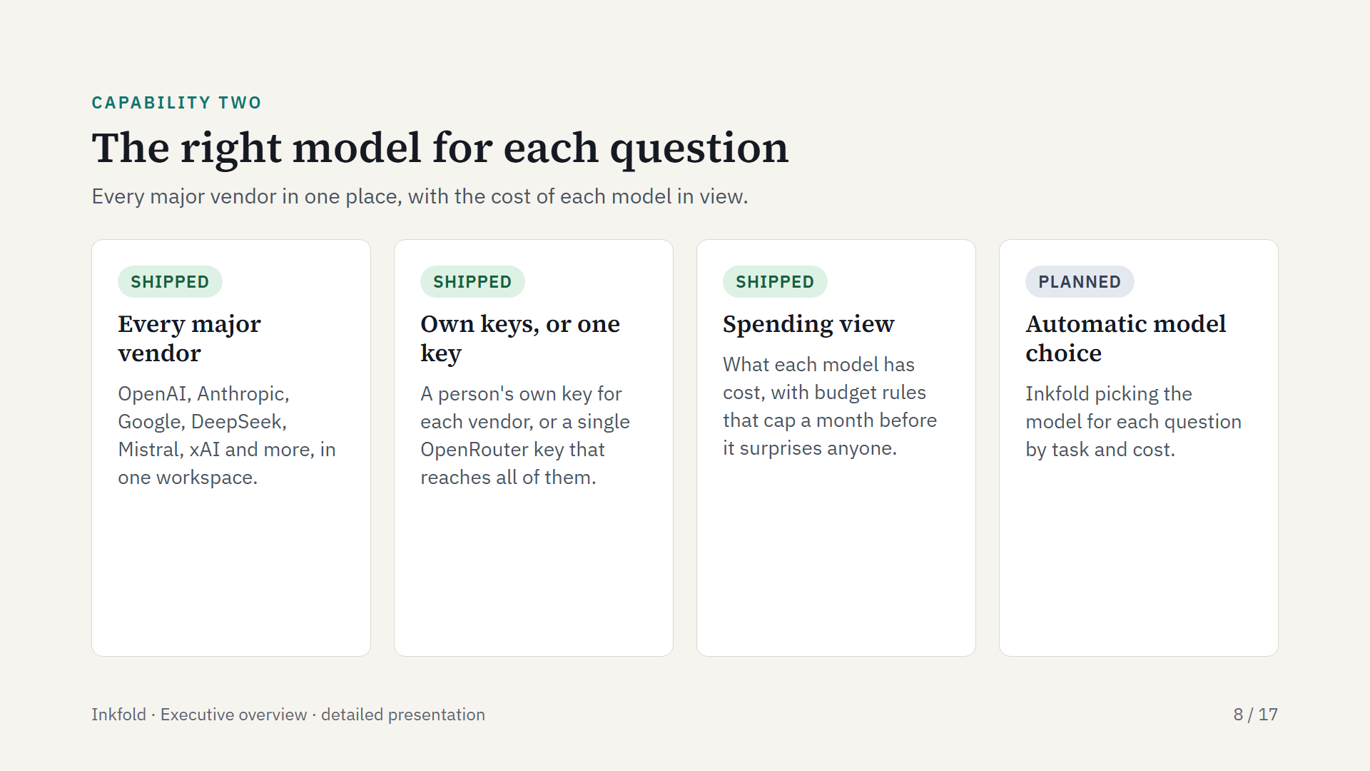
Notes:
Today the person chooses the model; Inkfold remembers across all of them and shows the cost. The small-business example: everyday questions are answered cheaply, while the model asked to draft a client proposal costs more, and a budget rule caps the month. Automatic model choice is coming; the FusionLayer engine underneath already has routing strategies such as cheap first, then strong.

Slide 9
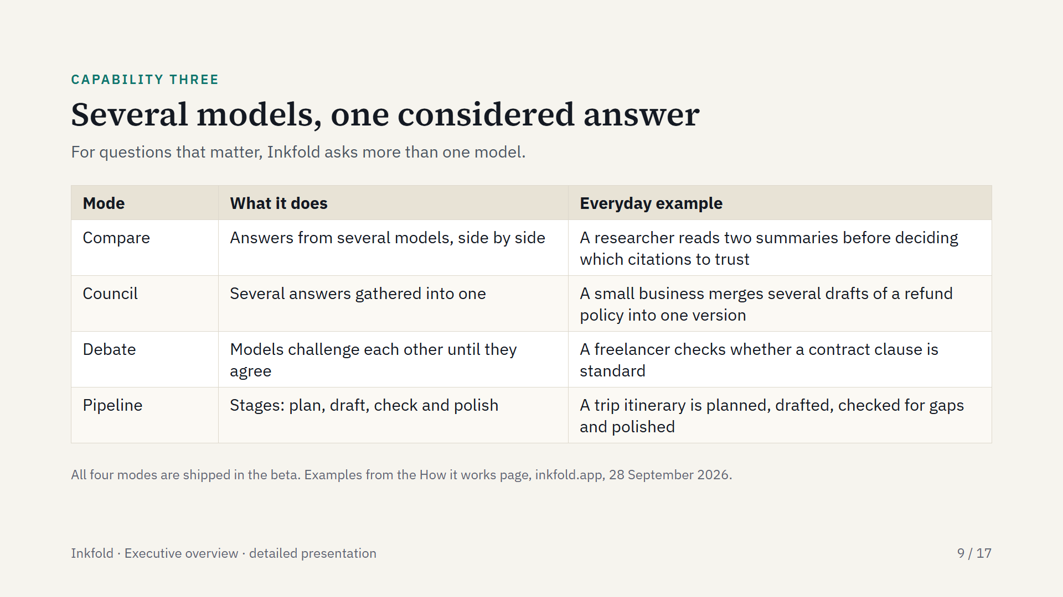
Notes:
This is what one-vendor apps do not do: put models from different vendors to work on the same question. Compare shows the spread of views, Council combines them, Debate makes them test each other until they reach an agreed answer, and Pipeline splits the work into stages. Each mode uses several model calls, so the planned Pro plan includes them.

Slide 10
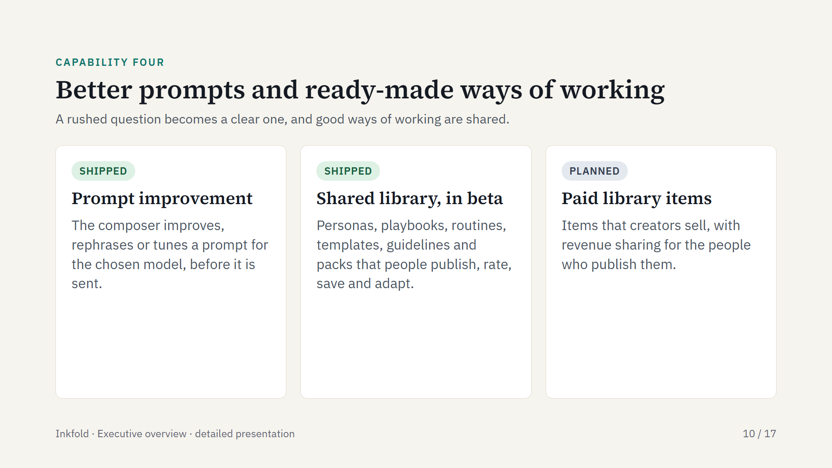
Notes:
Library examples: a research, cite and summarize playbook; patient tutor and formal academic personas; a weekly stand-up summary routine; a be-concise guideline; a trip-planning pack. Items are small readable files in the open FusionLayer Primitives format and are digitally signed, so the author and the content can be checked. Nothing in the library is charged today.

Slide 11
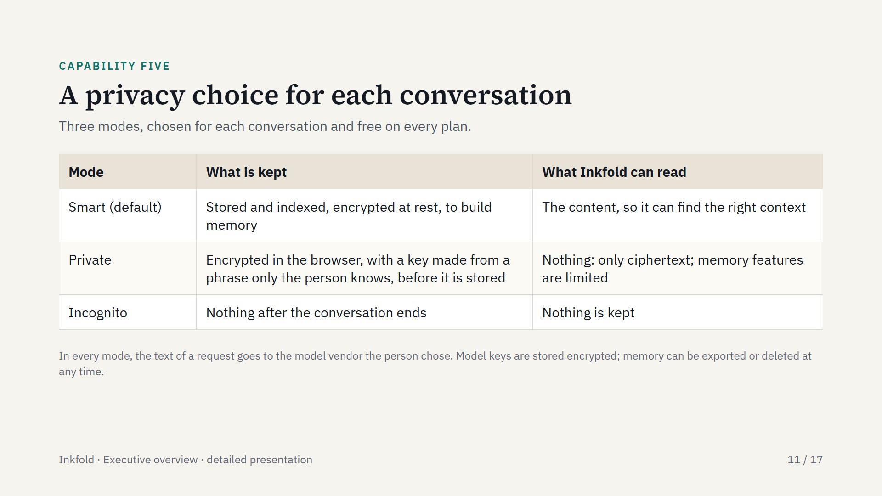
Notes:
Privacy is a choice for each conversation, and no mode is behind a paid plan. Smart gives the best recall. Private means Inkfold stores only what it cannot read, and cannot restore a lost phrase. Incognito keeps nothing.

Slide 12
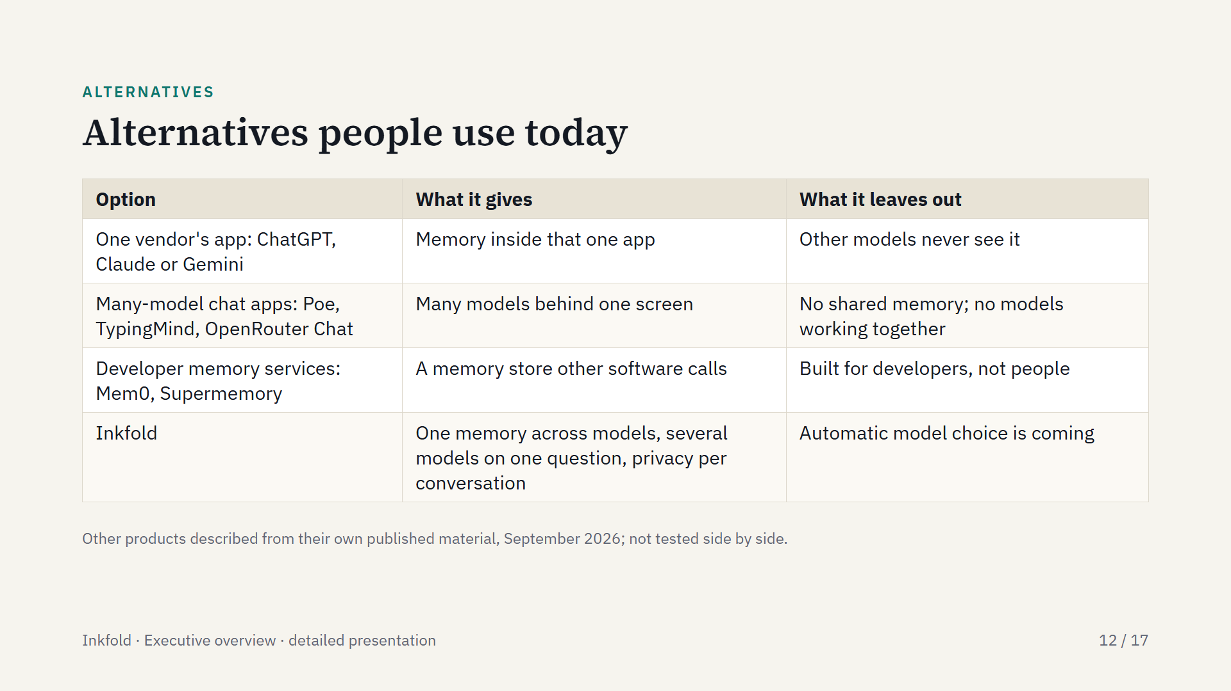
Notes:
One vendor's app is often enough for someone who uses one model. Inkfold is for people who use more than one assistant and want those models to share what they know, and to work together on questions that matter.

Slide 13
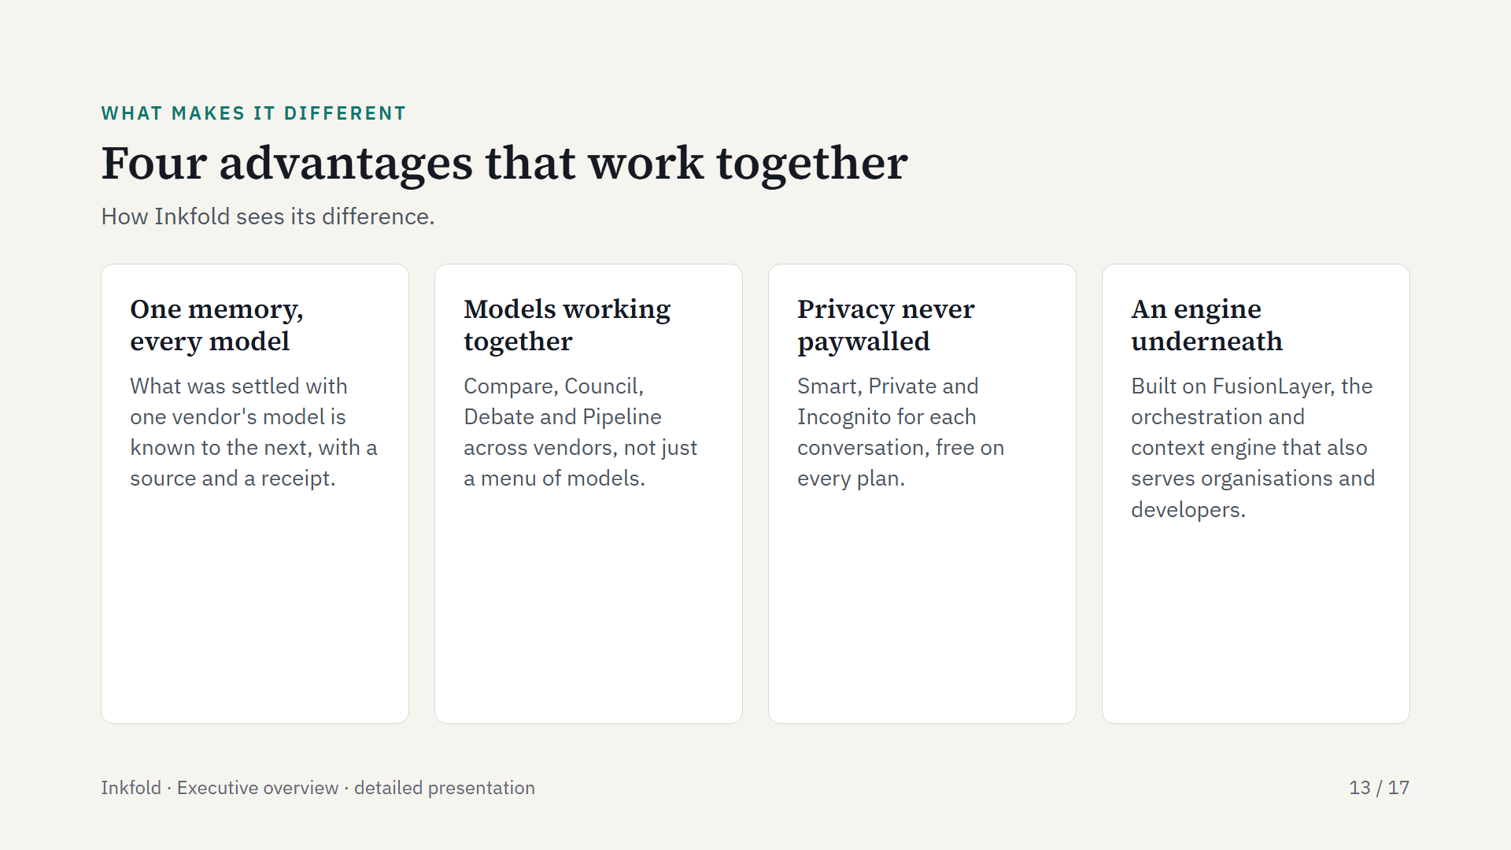
Notes:
Each advantage strengthens the others. Shared memory makes several models useful together, because each starts from the same context. Per-conversation privacy lets people bring more of their work into one place. The FusionLayer engine carries memory, context, routing, multi-model processing and policy, so Inkfold stays focused on the person's experience.

Slide 14
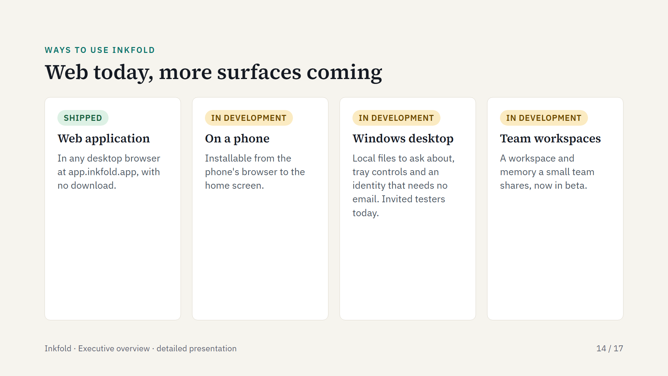
Notes:
The web application is the product today. The phone version is a responsive, installable web application going through device checks. The Windows desktop app is in the hands of invited testers ahead of a signed release. Team workspaces are in beta.

Slide 15
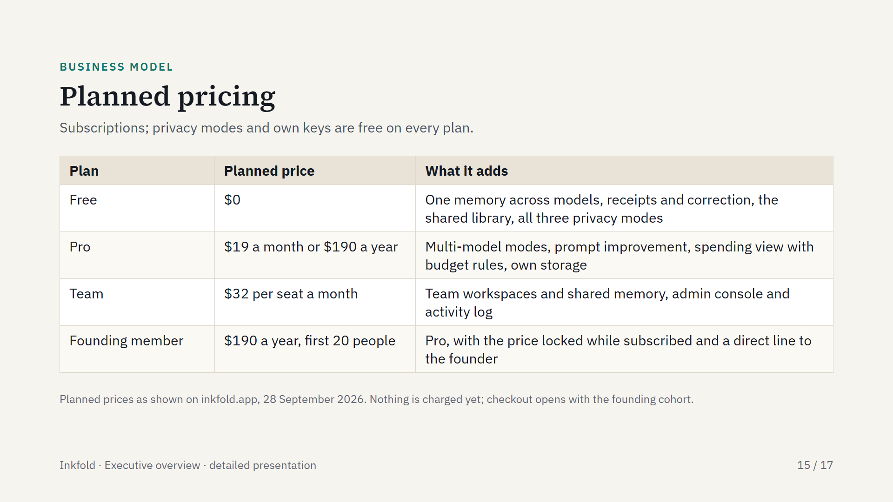
Notes:
Plans are subscriptions. Because people bring their own model keys, model usage is paid to the vendor directly; Inkfold-managed model messages are planned for later. Larger organisations can contact sales.

Slide 16
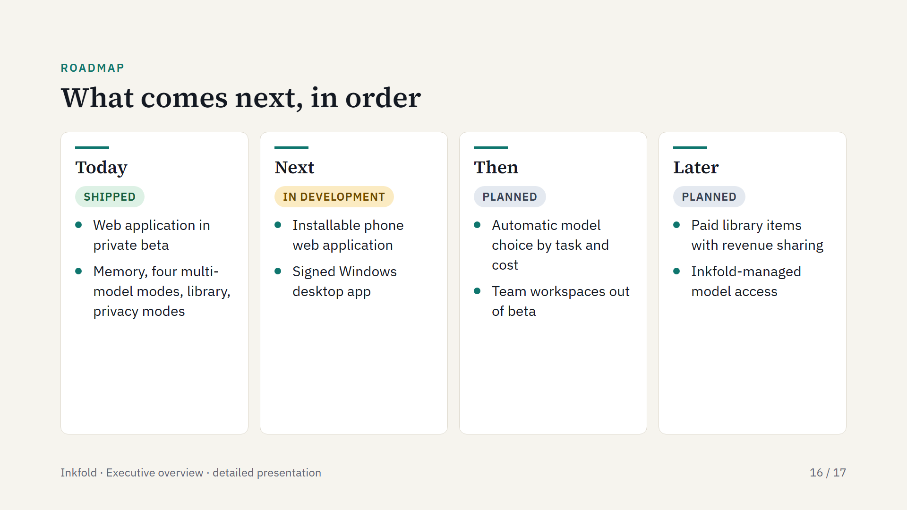
Notes:
The web application carries the core today; the phone and desktop surfaces are in development; automatic model choice builds on the FusionLayer engine's routing strategies; paid library items and managed model access come later.

Slide 17
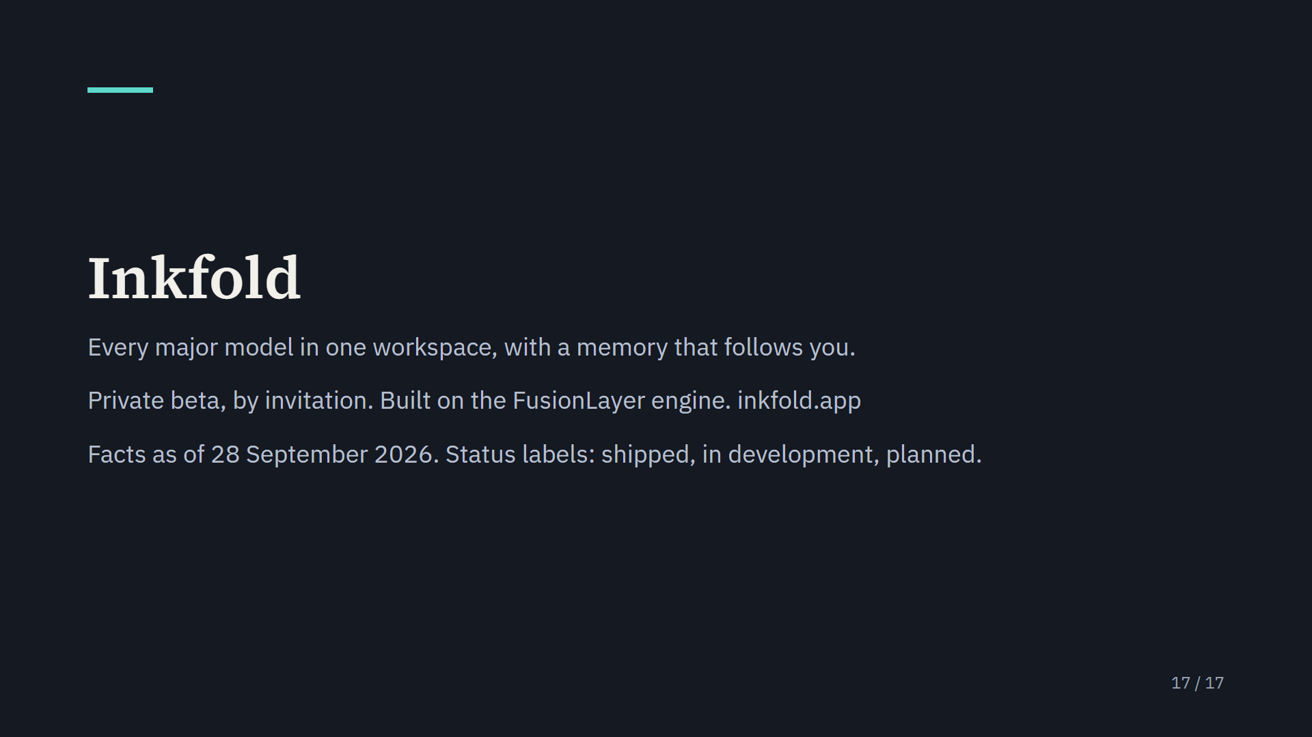
Notes:
The How it works page at inkfold.app walks through four everyday examples, and the Library page shows what people publish.

