Slide 1
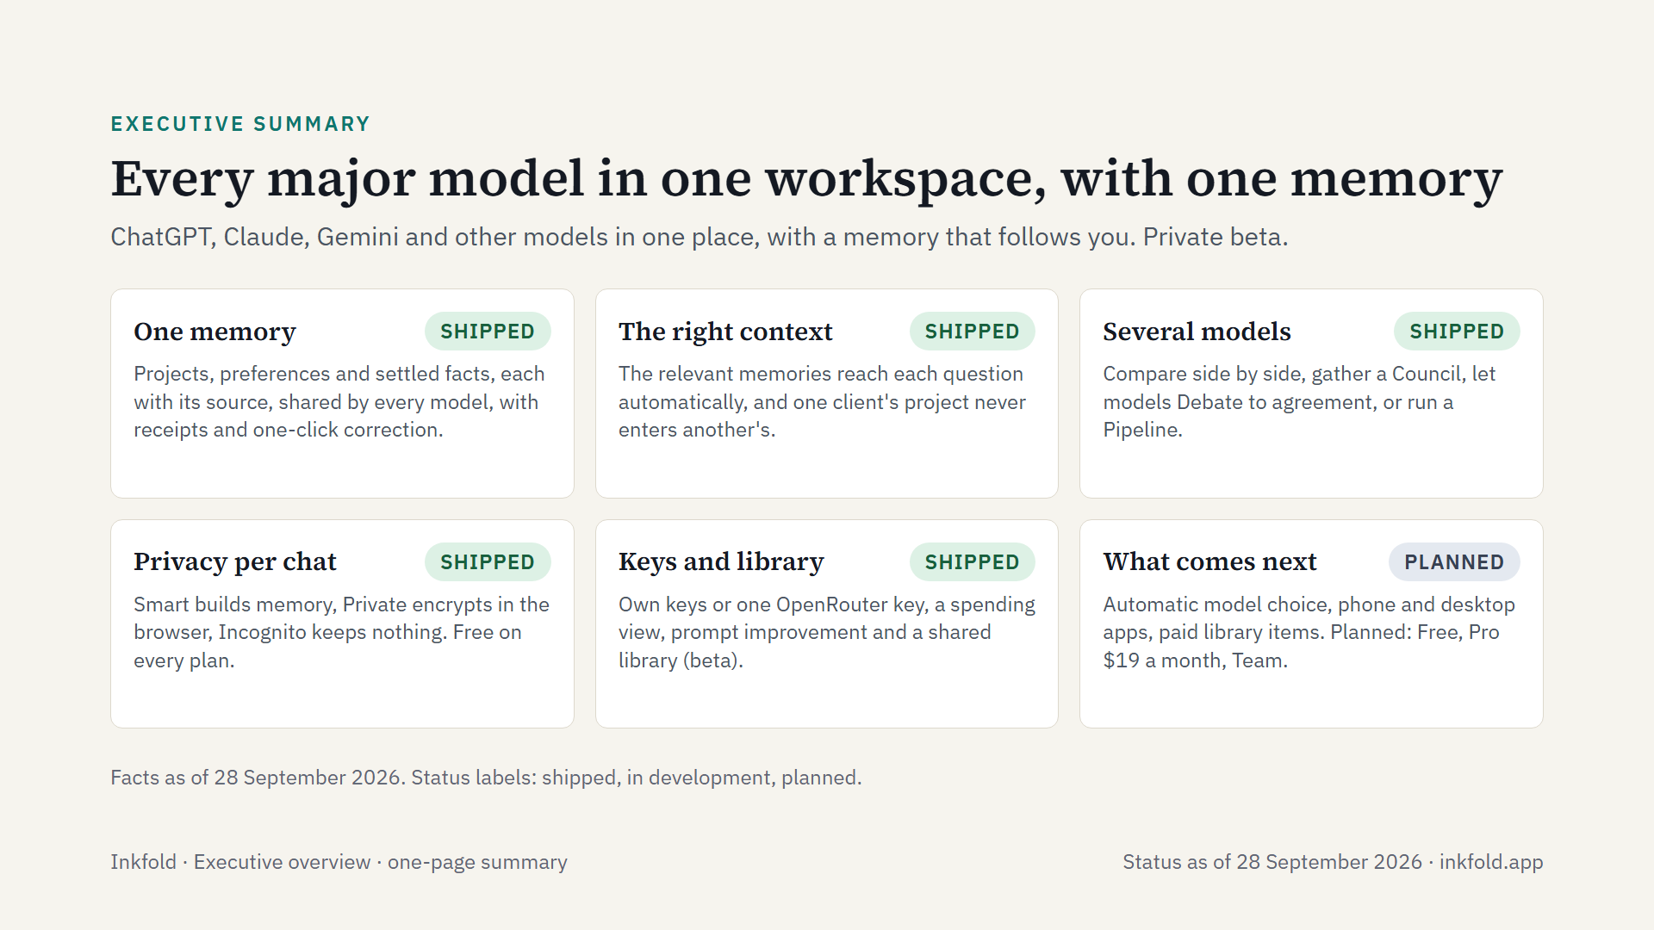
Notes:
Inkfold on one page, as of 28 September 2026. It is for people who use more than one assistant: writers and researchers, students, freelancers and independent professionals, and small businesses. It is built on the FusionLayer engine and is in private beta by invitation; prices are planned and nothing is charged yet.

