Slide 1
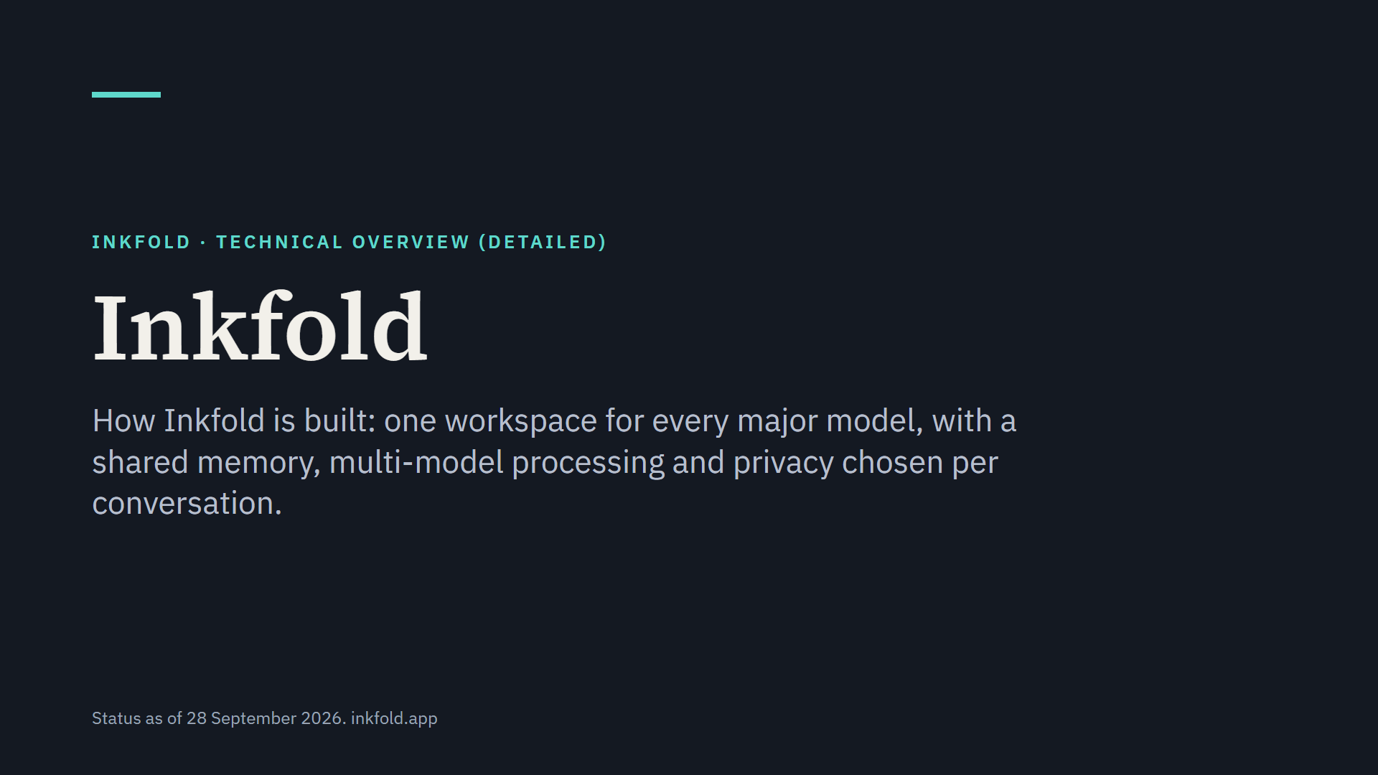
Notes:
This presentation explains how Inkfold works underneath: the architecture, the path of a question, memory and context, model access and multi-model processing, the shared library, privacy and security, and engineering practice.

Slide 2
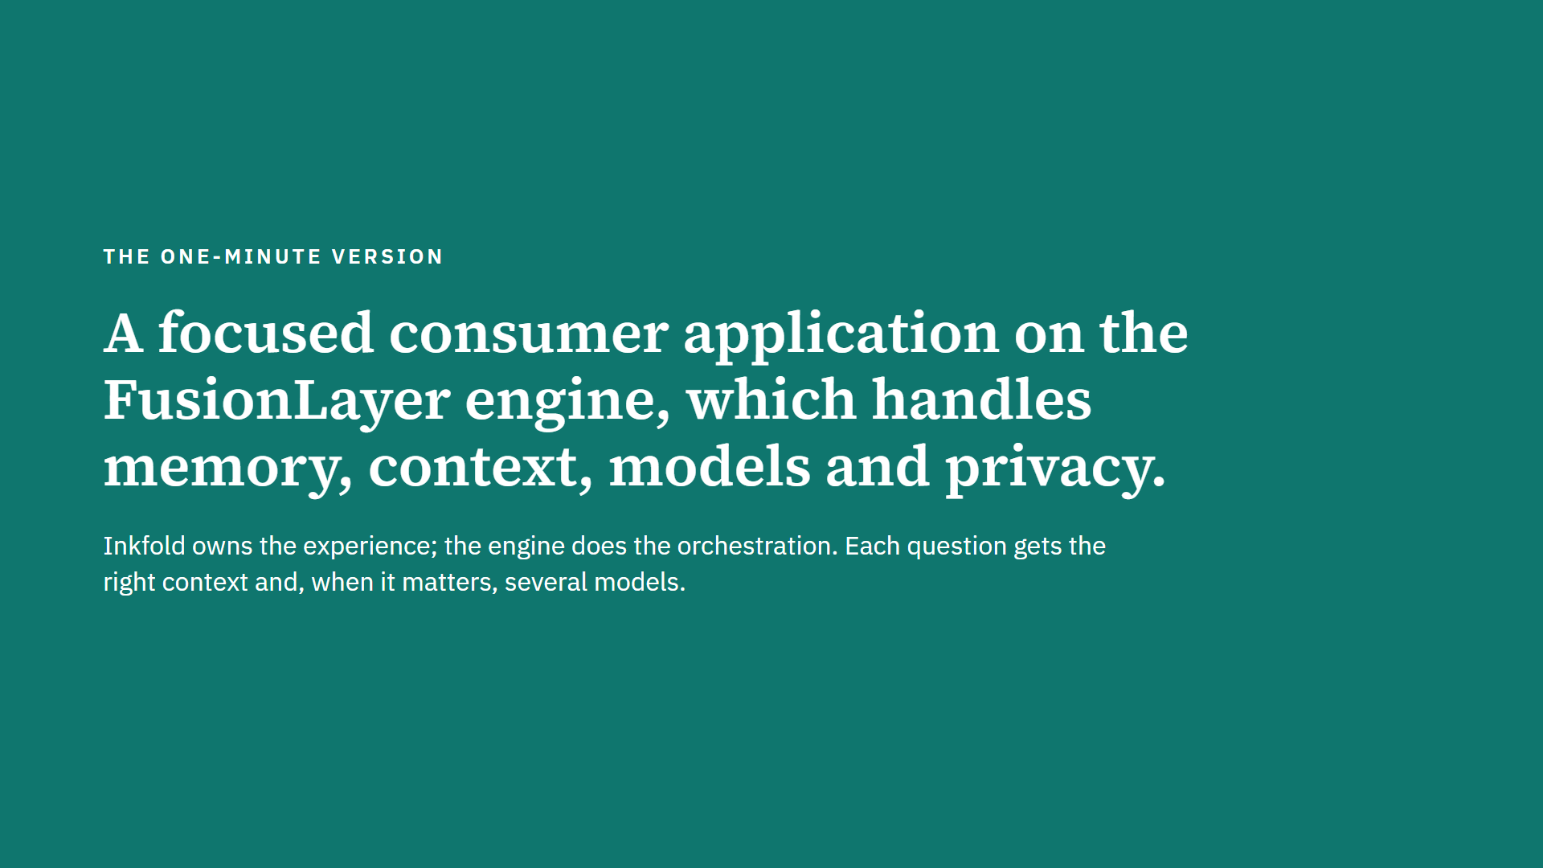
Notes:
Inkfold is deliberately thin: the web application and a small service own the person's experience, teams and the library, while the FusionLayer engine provides sign-in, memory, context assembly, model calls, multi-model processing, plan rules and privacy enforcement.

Slide 3
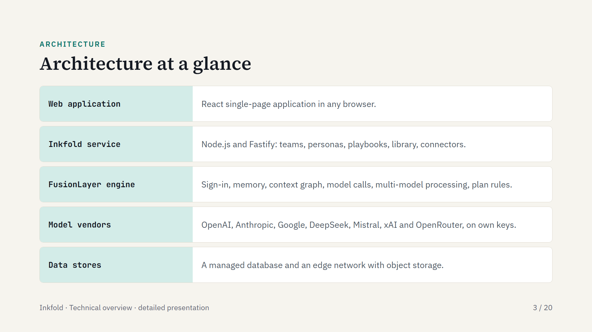
Notes:
Five layers, top to bottom. The browser talks to the Inkfold service and the engine; the service talks to the engine only through signed calls; the engine calls the vendor the person chose.

Slide 4
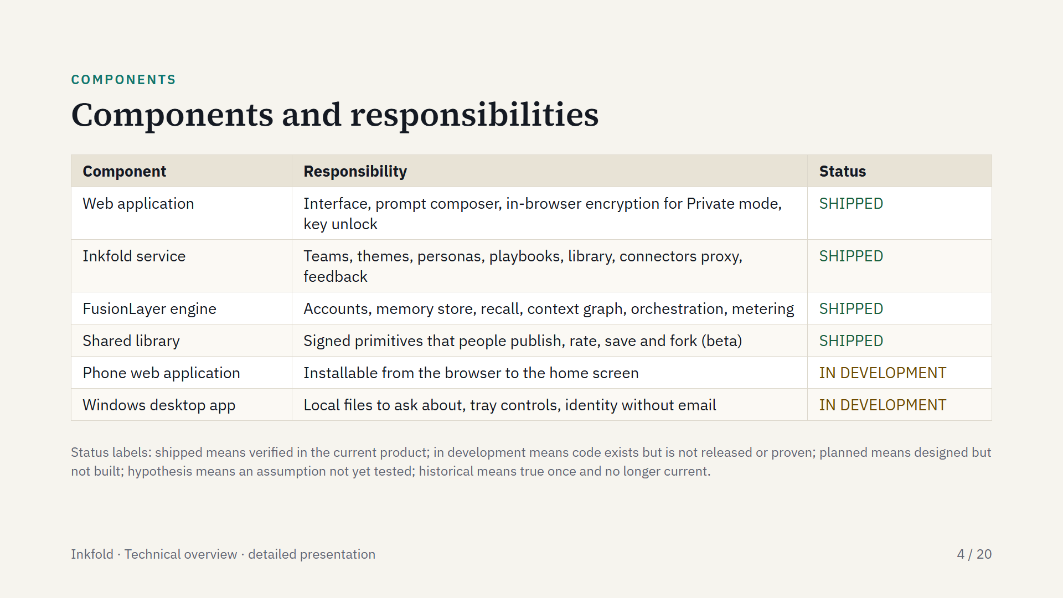
Notes:
The web application and service live in one code base with six packages; the engine is a separate code base and a separate product. The phone web application and the Windows desktop app are in development.

Slide 5
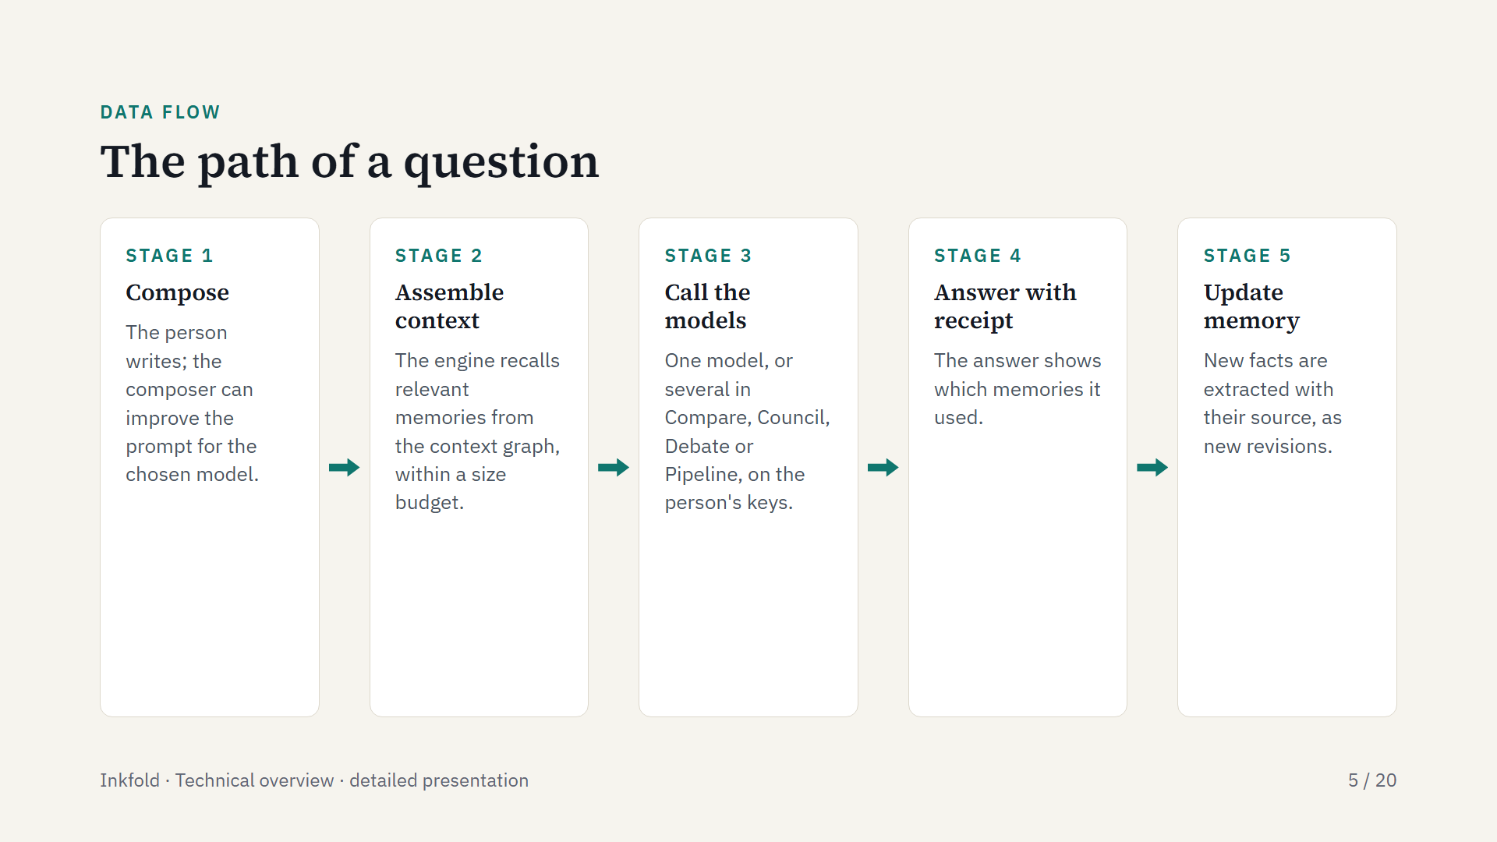
Notes:
Each question follows the same path. In Private mode the extraction step is limited because Inkfold stores only ciphertext; in Incognito nothing is kept after the conversation.

Slide 6
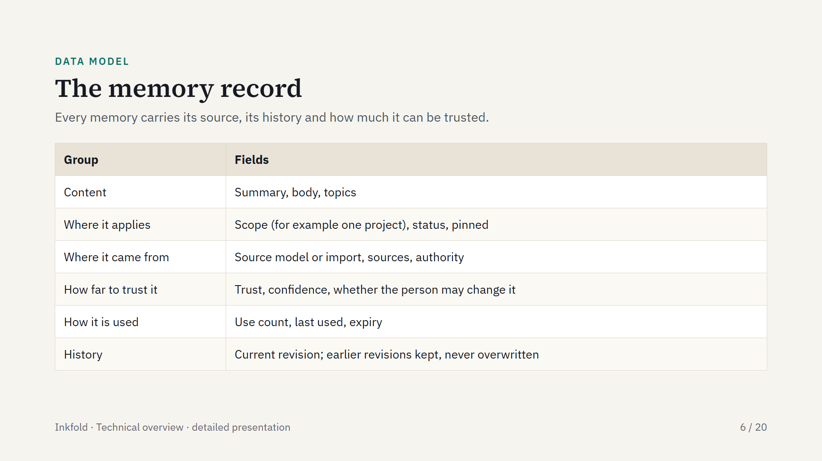
Notes:
A memory is a record with provenance, not a loose transcript. These fields drive the receipt under each answer and the one-click correction.

Slide 7
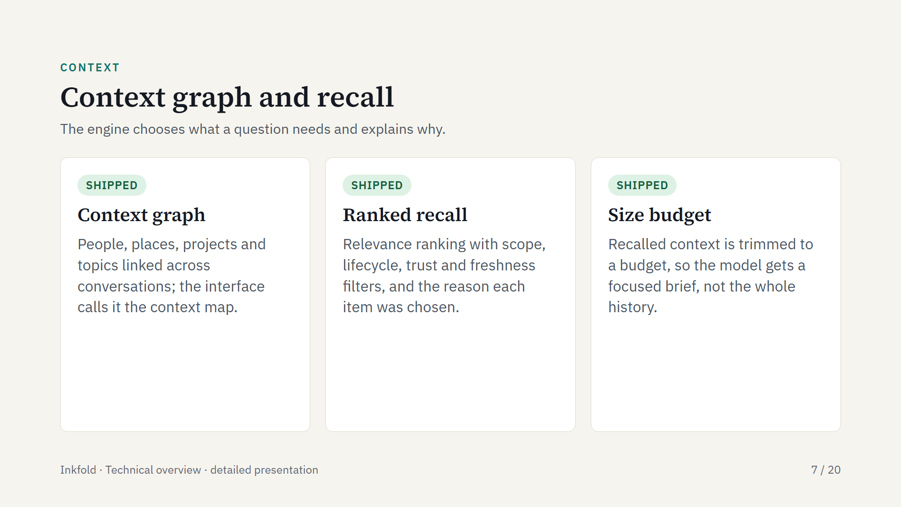
Notes:
Scope keeps projects apart: a question about one client recalls that client's memories only. The engine also returns exact source references with each recalled item, which is what the receipt displays.

Slide 8
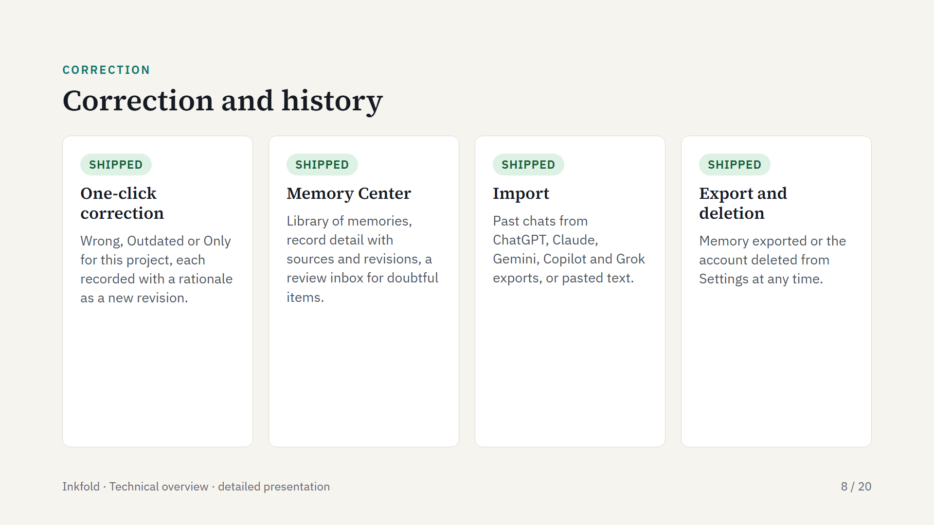
Notes:
Corrections never erase history: the engine withdraws, expires or re-scopes a record and keeps the earlier revision. Doubtful extractions go to the review inbox rather than straight into memory.

Slide 9
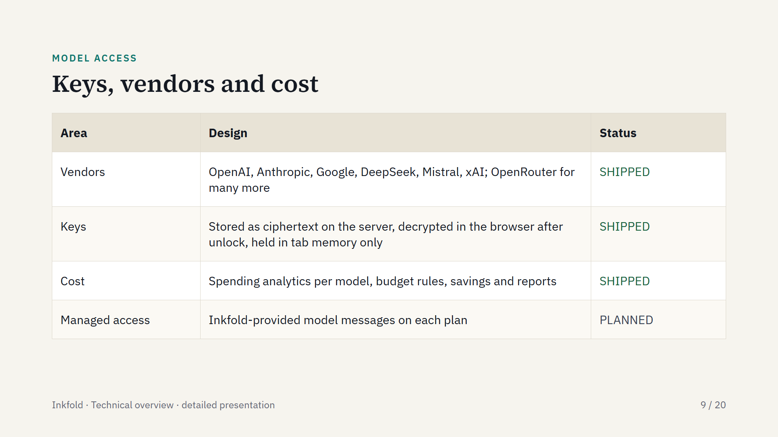
Notes:
The person's own keys are the beta path, so Inkfold never marks up model usage. The engine underneath supports fourteen vendors plus local models; Inkfold exposes the major ones and OpenRouter.

Slide 10
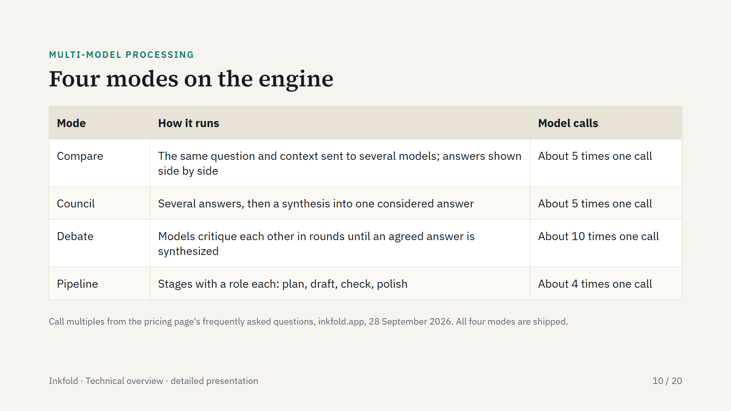
Notes:
All modes share the same assembled context, so every model starts from the same memory. Because they multiply model calls, they sit in the planned Pro plan and the spending view shows their cost. The engine also offers an ensemble mode: draft, critique and refine.

Slide 11
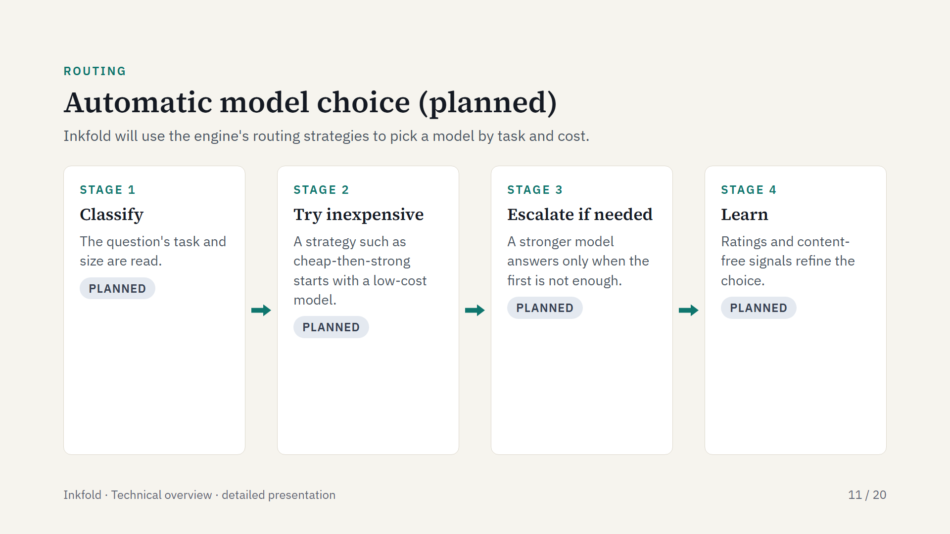
Notes:
Routing strategy files already exist in the FusionLayer engine; automatic model choice inside Inkfold is planned, and today the person picks the model. Content-free signals mean model, response time, cost and satisfaction, never the conversation.

Slide 12
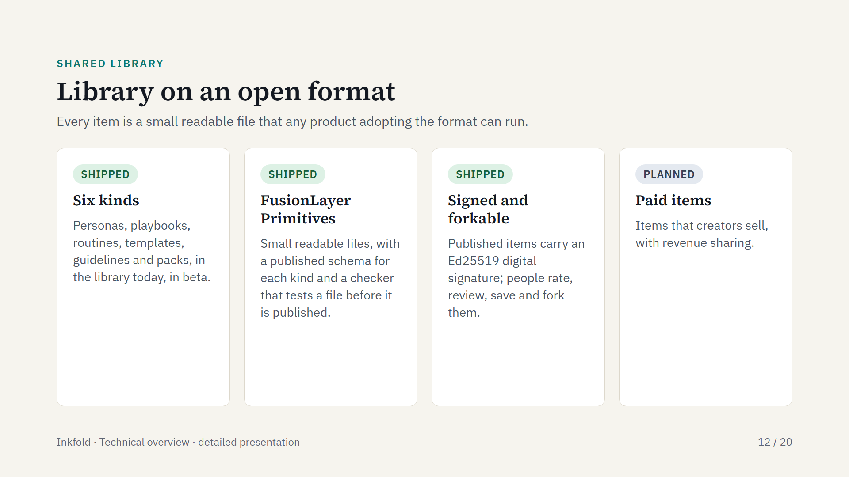
Notes:
The format also covers policy and routing kinds; the site shows a policy primitive that redacts personal information as an example. The signature lets anyone check who wrote an item and that it was not changed.

Slide 13
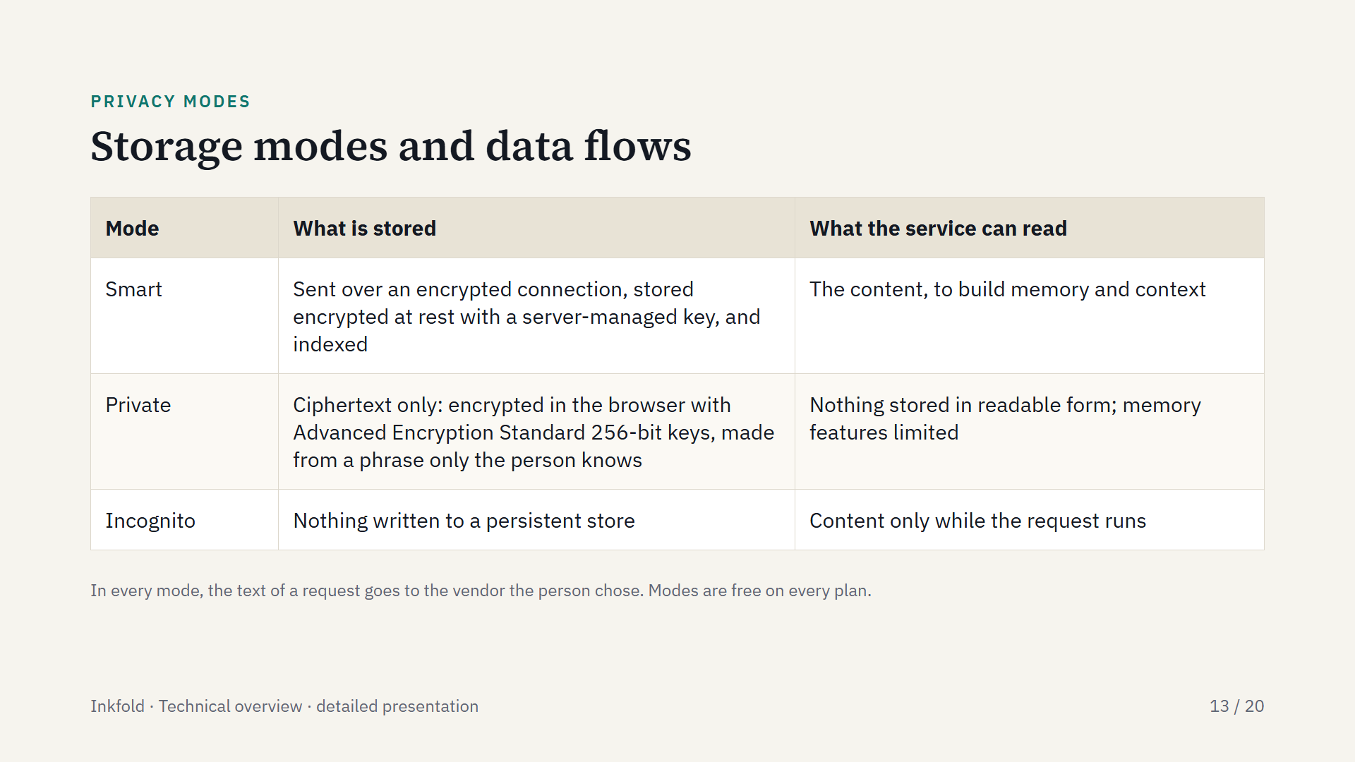
Notes:
The mode is enforced by the server for each conversation, with a per-account default. In Private mode the key is derived from the person's phrase with Argon2id and then a key-derivation step, content passes through the servers briefly in memory for dispatch to the vendor, and a lost phrase cannot be restored.

Slide 14
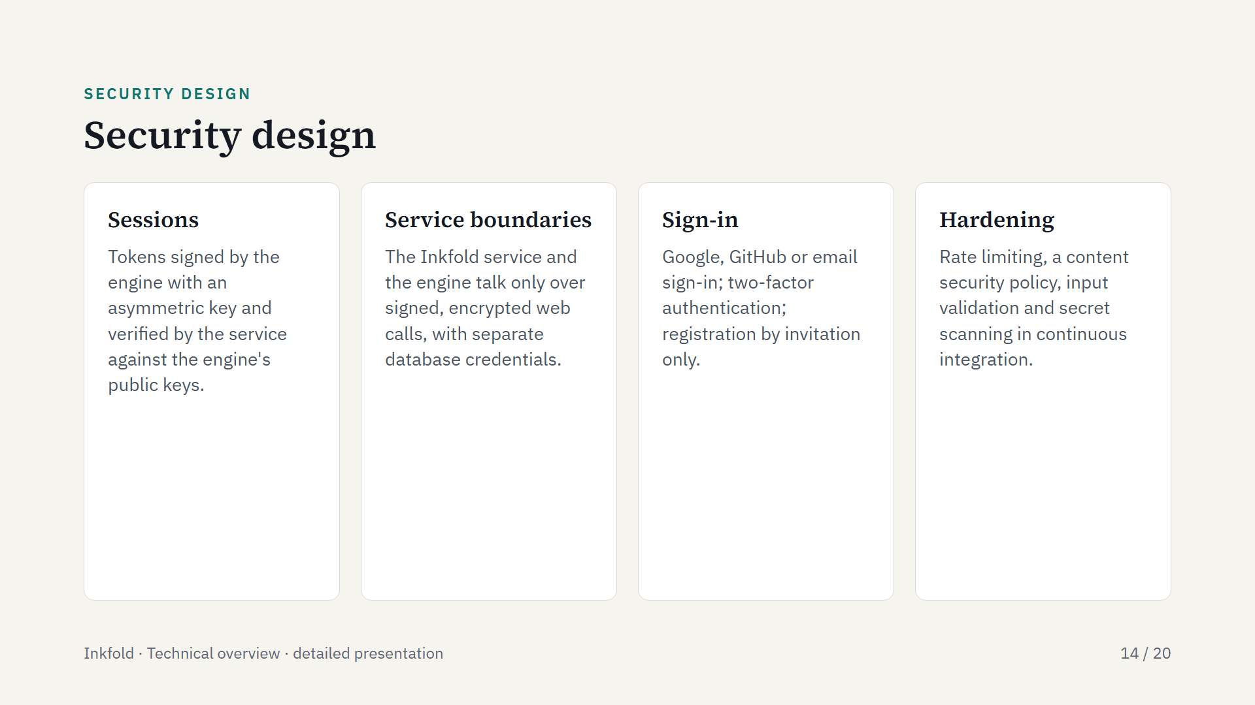
Notes:
Model keys never leave the browser in readable form, and the service refuses to start in production if settings are missing or test and production settings are mixed.

Slide 15
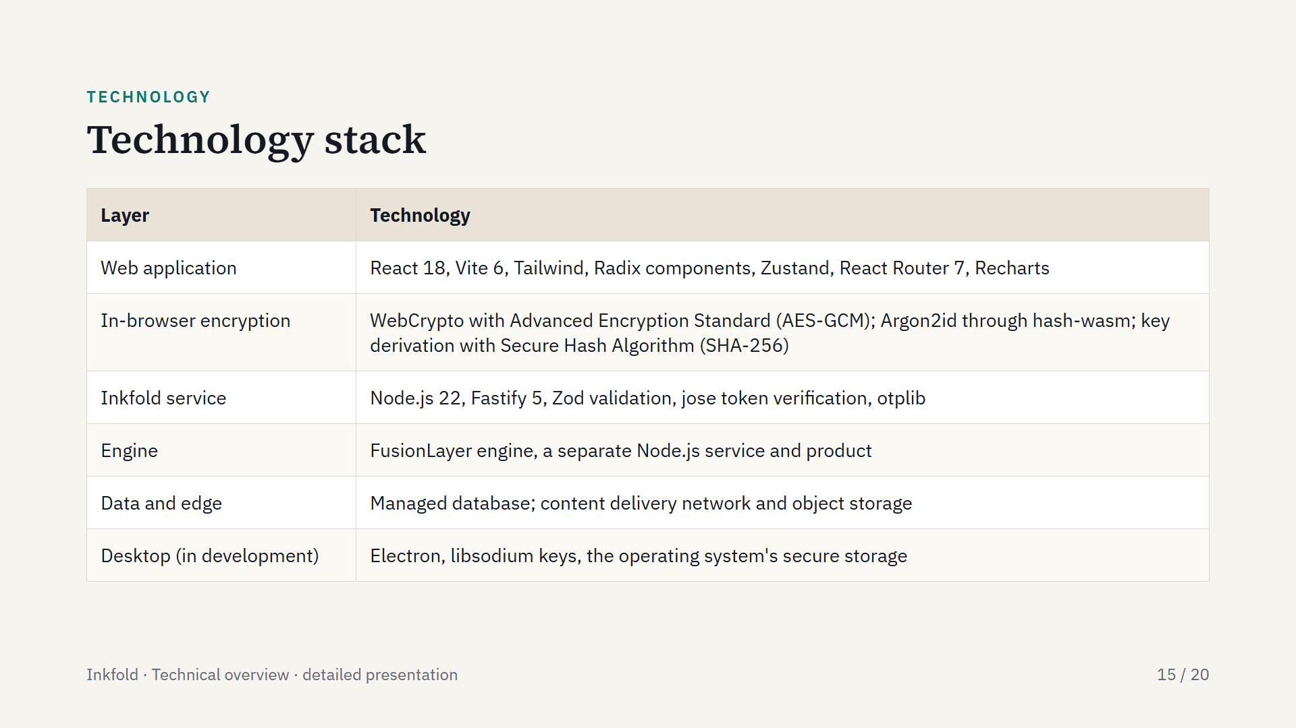
Notes:
A mainstream JavaScript stack end to end, which keeps the web application, service and desktop app in one language.

Slide 16
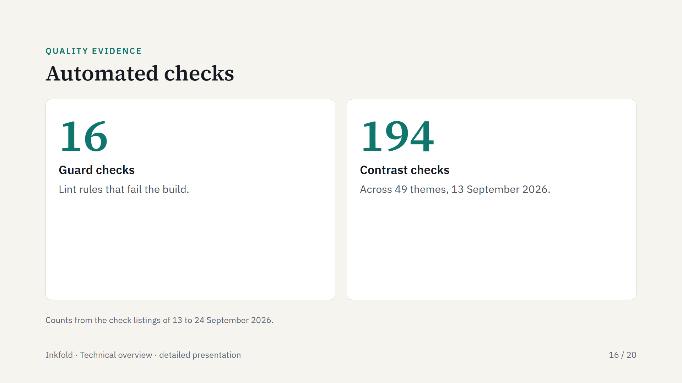
Notes:
Guard checks include engine boundary rules, cross-database access, migration collisions, navigation ownership and cost-multiplier wording. Accessibility checks run in the web tests, and a phone-screen check runs on every change.

Slide 17
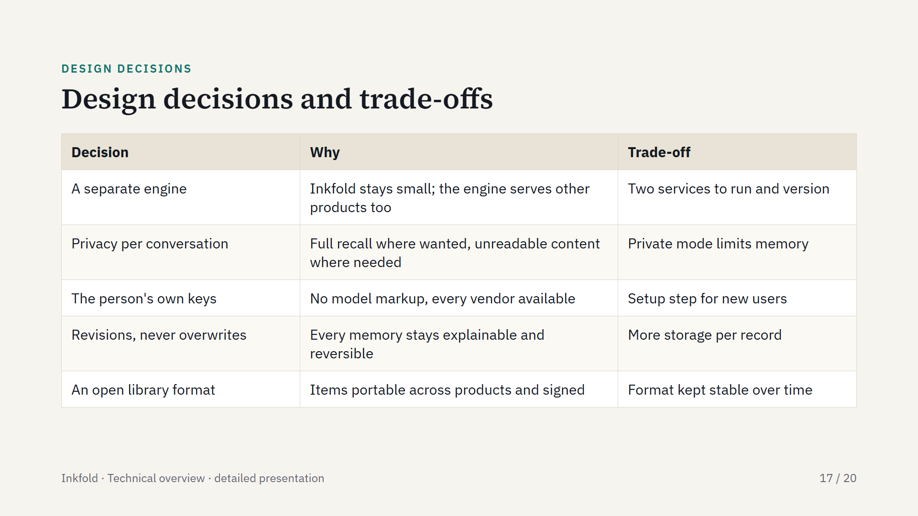
Notes:
The privacy decision is recorded in the engine's decision record, full fidelity over zero knowledge: the engine serves readable content in Smart mode and ciphertext it cannot read in Private mode, chosen per conversation. A second decision record makes FusionLayer a licensable engine for outside clients, of which Inkfold is the first.

Slide 18
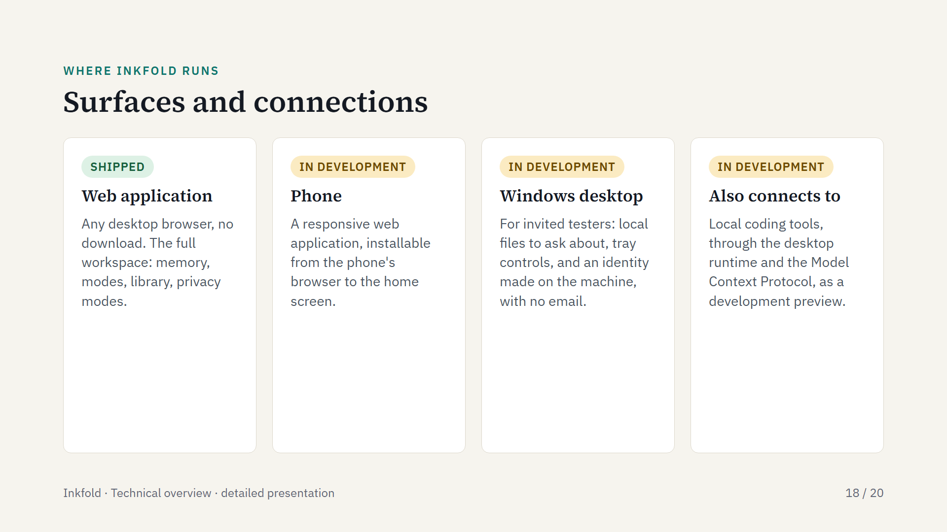
Notes:
The web application is the product today. The desktop tester build bundles a local runtime that can also connect local coding tools as a development preview; that is a side connection, not the product's focus.

Slide 19
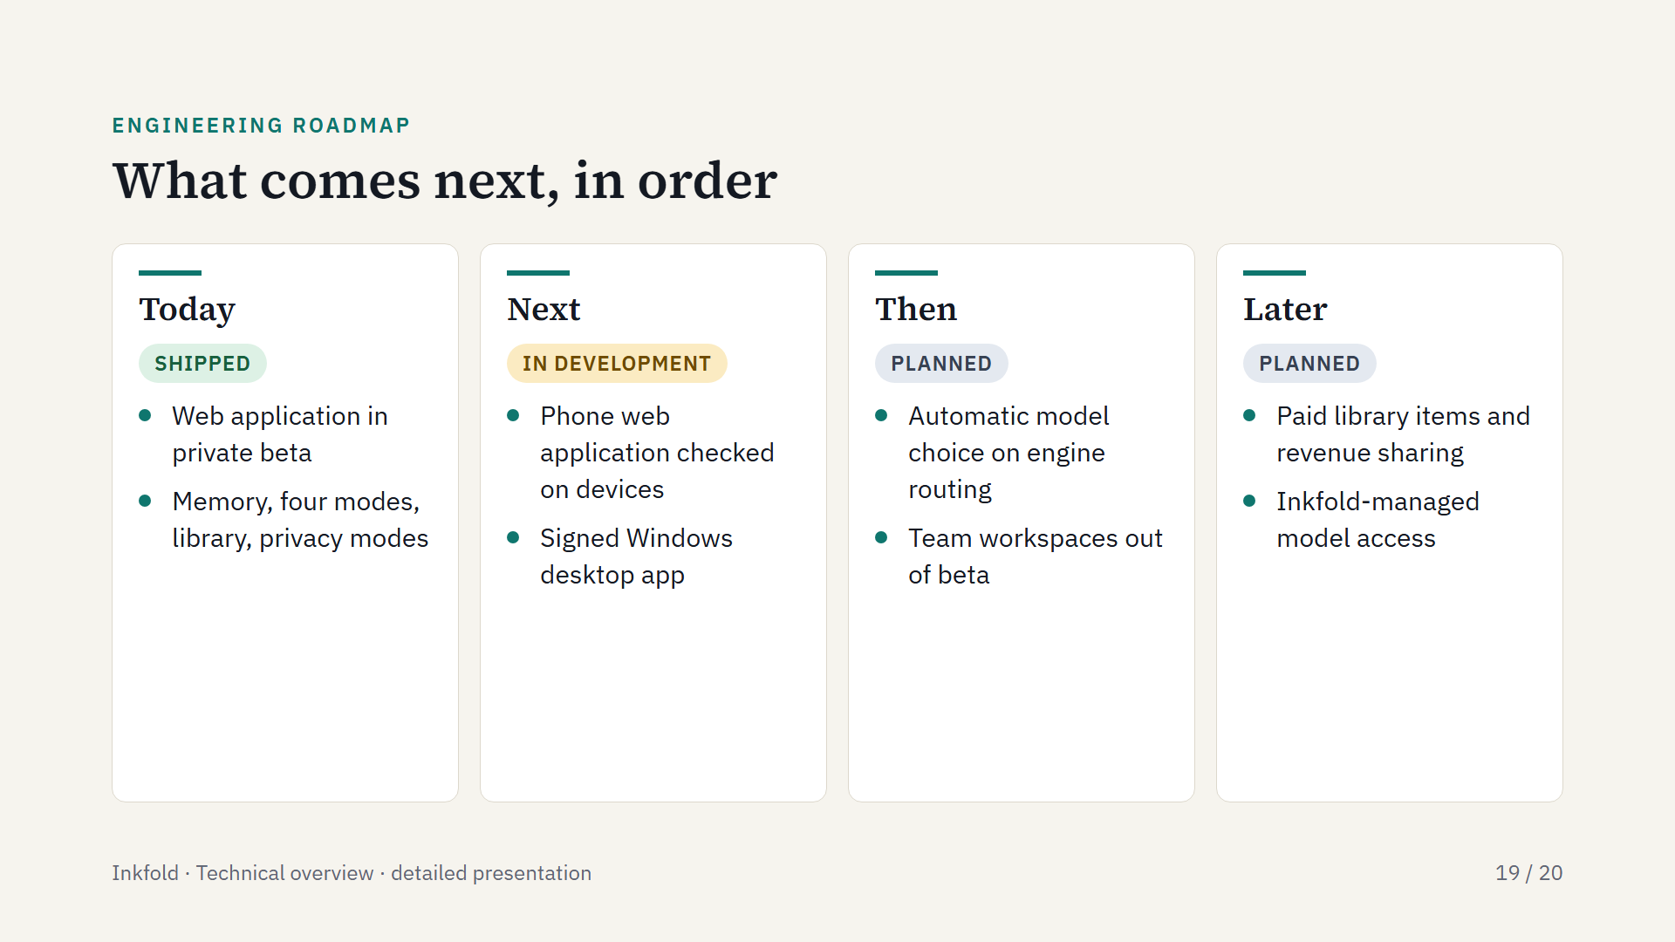
Notes:
Each stage builds on what is already in place: the desktop app has a tester build, team workspaces are in beta, and routing strategies exist in FusionLayer.

Slide 20
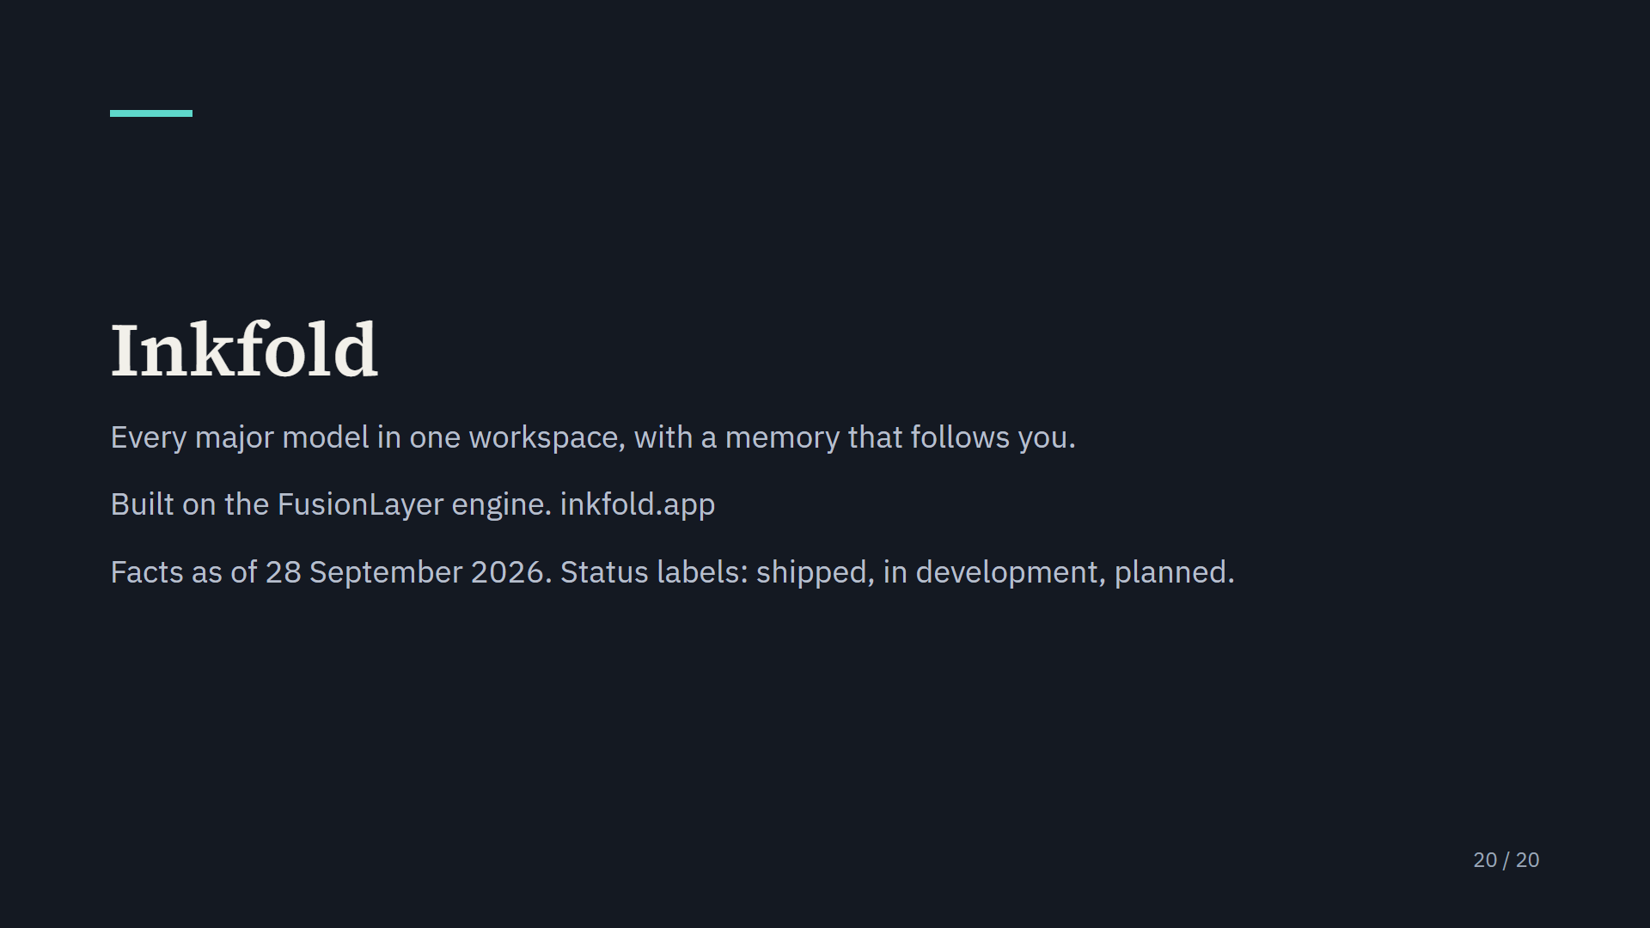
Notes:
The FusionLayer engine that Inkfold is built on has its own site at fusionlayer.app.

