Slide 1
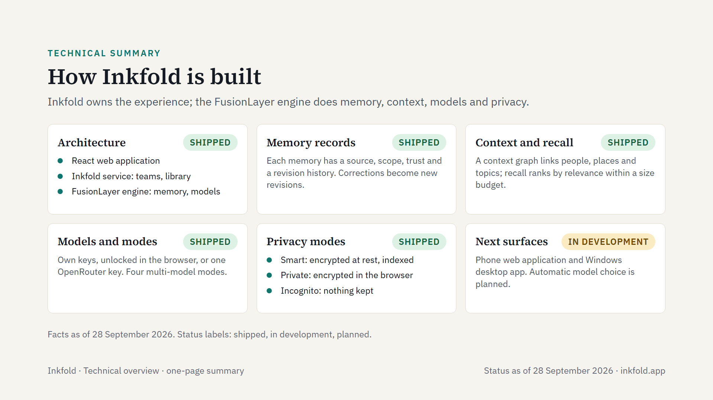
Notes:
Inkfold's technical design on one page, as of 28 September 2026. In every mode, the text of a request goes to the model vendor the person chose. Library items use the open FusionLayer Primitives format and carry a digital signature.

